Slide 1
Analytical Chemistry
1st Stage Students
Reduction and Oxidation
lecture
By:
Dr. Hussein Nasser AL-Salman

Slide 2
Reduction and Oxidation
(redox chemistry)

Slide 3
What is a redox reaction?
Oxidation is the addition of oxygen to a substance and
Reduction is the removal of oxygen from a substance.
Which substances are oxidized and reduced in this reaction?
oxygen removed
reduction
lead oxide
+
carbon
➔
lead
+
carbon monoxide
oxygen added
oxidation
Reduction and oxidation always take place together. Why is this type of reaction called a redox reaction?
redox = reduction and oxidation

Slide 4
Redox reactants – oxidized or reduced?
Notes:
Teacher notes
This drag and drop activity could be used as a plenary exercise to check students’ ability to identify when reactants are oxidized and reduced. Class voting or the use of coloured traffic light cards could make this a whole-class exercise. Alternatively, students could be asked to complete the table in their books and the activity could be concluded by the completion on the IWB.

Slide 5
Redox and electrons
Magnesium burns in oxygen to form magnesium oxide.
It is obvious that the magnesium has been oxidized, but what has happened to the oxygen?
A redox reaction can also be explained in terms of the gain or loss of electrons.
What happens to the atoms and electrons in this reaction?
➔
magnesium + oxygen magnesium oxide
2Mg(s)
+
O₂(g)
➔
2MgO(s)
Notes:
Photo credit: Jeronen Ven
Sparks produced by the combustion of magnesium.

Slide 6
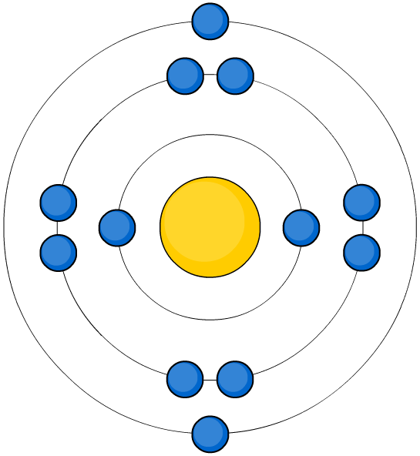
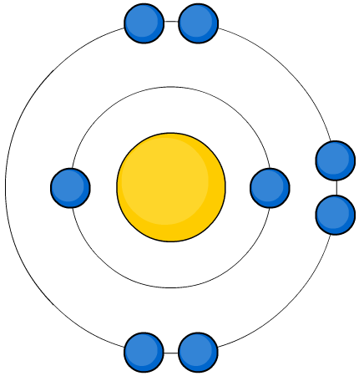
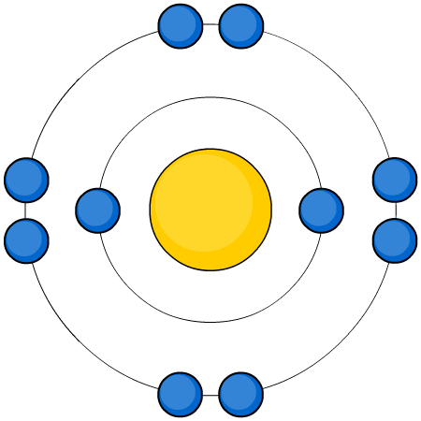
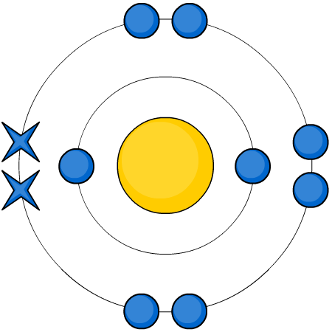
Oxidation and electron loss
When magnesium burns in oxygen to form magnesium oxide, what happens to magnesium and its electrons?
oxidized
(electrons lost)
Mg
+
O
➔
Mg²⁺
O²⁻
The magnesium has been oxidized.
The Mg atom has lost 2 electrons to form a Mg²⁺ ion.
Oxidation is the loss of electrons.

Slide 7
Oxidation and electron gain
When magnesium burns in oxygen to form magnesium oxide, what happens to oxygen and its electrons?
reduced
(electrons gained)
Mg
+
O
➔
Mg²⁺
O²⁻
The oxygen has been reduced.
The O atom has gained 2 electrons to form a O²⁻ ion.
Reduction is the gained of electrons.

Slide 8
Using OILRIG
What does OILRIG stand for in terms of redox reactions?
Oxidation
Is
Loss of electrons
Reduction
Is
Gain of electrons

Slide 9
What is a half-equation?
Redox reactions involve the transfer of electrons.
Equations written to show what happens to the electrons during oxidation and reduction are called half-equations.
What are the half-equations for the oxidation and reduction processes in this reaction?
➔
magnesium + oxygen magnesium oxide
2Mg (s)
+
O₂ (g)
➔
2MgO (s)
oxidation: Mg → Mg²⁺ + 2e⁻
reduction: O₂ + 4e⁻ → 2O²⁻

Slide 10
Redox half equations

Slide 11
Balancing half equations

Slide 12
Balancing more challenging examples
Balance all atoms (but not O or H yet)
Eg Cr₂O₇²⁻ → 2Cr³⁺
Balance O by adding H₂O to the other side
Eg Cr₂O₇²⁻ → 2Cr³⁺ + 7H₂O
Balance H by adding H⁺ to the other side
Eg 14H⁺ + Cr₂O₇²⁻ → 2Cr³⁺ + 7H₂O
Balance charge by adding electrons (e⁻)
Eg 14H⁺ + 6e⁻ + Cr₂O₇²⁻ → 2Cr³⁺ + 7H₂O

Slide 13
Combining half equations

Slide 14
Oxidizing and reducing agents
Common oxidizing agents:
Common reducing agents:
concentrated sulfuric acid (H₂SO₄)
hydrogen (H₂)
zinc (Zn)
potassium manganate(VII) (KMnO₄)
carbon (C)
potassium dichromate(VI) (K₂Cr₂O₇)
carbon monoxide (CO)
manganese(IV) oxide (MnO₂)
lithium tetrahydrido-aluminate(III), (LiAlH₄)
chlorine (Cl₂)
sodium tetrahydrido-borate(III) (NaBH₄)
hydrogen peroxide (H₂O₂)
Notes:
Teacher notes
Other common oxidizing agents include chromium(VI) oxide (CrO₃) and sodium peroxide (Na₂O₂).
Lithium tetrahydridoaluminate(III) is also known as aluminium hydride, and sodium tetrahydridoborate(III) is also known as sodium borohydride. They are common organic reducing agents.

Slide 15
Spot the agent

Slide 16
Oxidation numbers
Notes:
Teacher notes
The oxidation number of an atom tells you its relative state of oxidation, compared to an element on its own because an element on its own has an oxidation state of zero.
There are some exceptions to the special examples in rule 3. For example:
Hydrogen in metal hydrides (hydrogen has oxidation state -1 in NaH).
Oxygen in peroxides (oxygen has oxidation state +1 in H₂O₂).
Oxygen in compounds with fluorine, because fluorine is more electronegative than oxygen (oxygen has oxidation state +2 in F₂O).
Chlorine in compounds with fluorine or oxygen, because fluorine and oxygen are more electronegative than chlorine (chlorine can take one of several different oxidation states in these compounds).

Slide 17
Working out oxidation numbers

Slide 18
Comparing reactivity
The orders of reactivity of metals with water, oxygen and air can be compared.
with water
with oxygen
with acid
potassium
calcium
calcium
sodium
magnesium
magnesium
lithium
zinc
aluminium
magnesium
iron
zinc
copper
lead
iron
silver
copper
lead
gold
copper
What patterns can you see in these lists?

Slide 19
What is the order of reactivity?

Slide 20
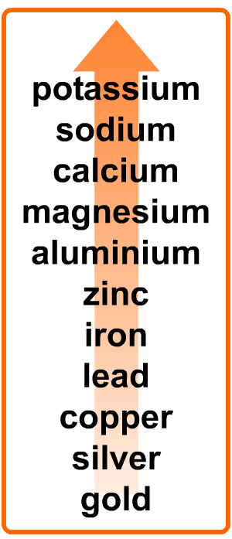
Predicting simple reactions
Use the reactivity series to predict if a reaction will take place and how intense the reaction will be:
metal
reacts with
prediction
gold
acid
no reaction
calcium
water
fizzing
sodium
oxygen
burns vigorously
silver
oxygen
very slow reaction
zinc
oxygen
burns moderately

Slide 21
What is needed for iron to rust?
Notes:
Reactivity and the Reactions of Metals Worksheet 2 accompanies this slide.

Slide 22
Rusting: true or false?

